Slide 1


Chapter 3
Network Function Virtualization (NFV)
Rami Tawil

Slide 2
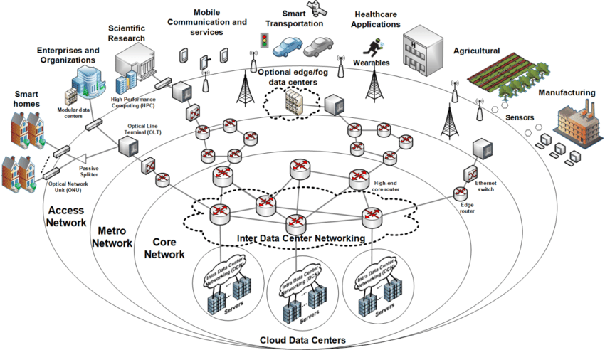
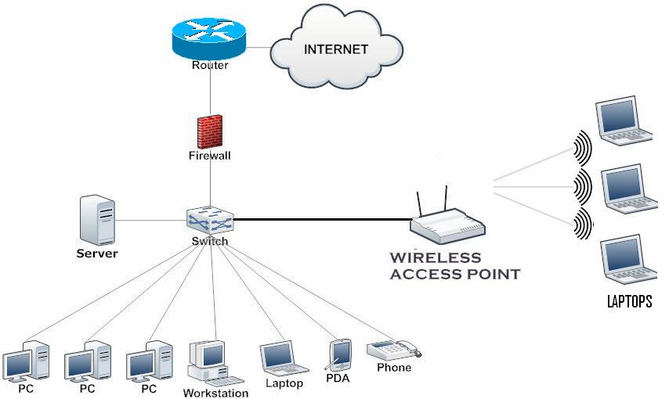
Evolution from Hardware-Based to Virtualized Network Functions
Traditional networks relied on proprietary hardware appliances for each network function.
Examples: routers, firewalls, load balancers, and intrusion detection systems.
Scaling and upgrading required costly physical installations.

Slide 3
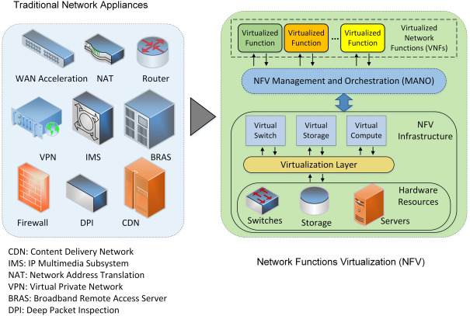
Evolution from Hardware-Based to Virtualized Network Functions
NFV replaces dedicated hardware with software-based Virtual Network Functions (VNFs) running on commodity servers.
This transition improves flexibility, scalability, and cost-efficiency.

Slide 4
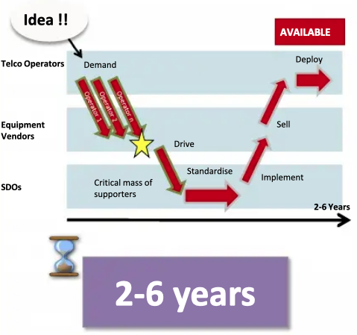
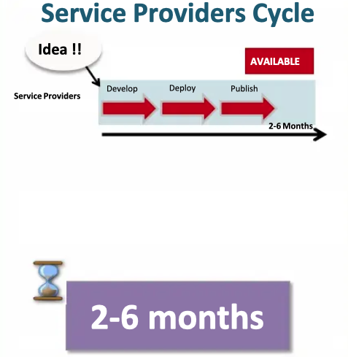
Implementing new idea
Virtualized Network Functions
Hardware-Based

Slide 5
Motivation and Advantages of NFV
Reduce dependency on proprietary network hardware.
Lower capital and operational costs (CAPEX and OPEX).
Enable rapid deployment of new network services.
Increase scalability through on-demand resource allocation.
Simplify management and automation using orchestration frameworks.
Enhance innovation by decoupling software from hardware vendors.

Slide 6
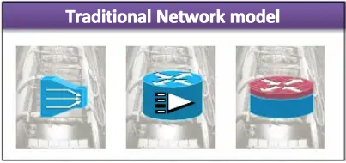
Problem Statement
Complex carrier networks with a large variety of proprietary nodes and hardware appliances.
Launching new services is difficult and takes too long
Space and power to accommodate
Requires just another variety of box, which needs to be integrated.
Operation is expensive
Rapidly reach end of life
Due to existing procure-design,-integrate-deploy cycle.
Network functionalities are based on specific HW&SW
One physical node per role Traditional Network model

Slide 7
NFV Use Cases: 5G, Cloud Services, IoT, and Enterprise Networks
5G Networks: Enables core network functions (EPC, AMF, SMF) as virtualized services.
Cloud Services: Supports scalable and flexible virtualized data centers.
IoT: Facilitates dynamic resource management for billions of connected devices.
Enterprise Networks: Allows deployment of virtual firewalls, VPNs, and load balancers on demand.
Notes:
AMF - Access and Mobility Management Function
SMF - Session Management Function
EPC - Evolved Packet Core: In 4G EPC, the control plane (signaling) and user plane (data traffic) are more tightly coupled. 5GC separates them completely, allowing for more flexibility and scalability. The 5G Core (with AMF/SMF) is a cloud-native, service-based architecture, while the EPC is a more traditional, node-based architecture.

Slide 8
NFV Architecture and Standards
European Telecommunications Standards Institute (ETSI) NFV Architectural Framework
Core components: NFVI, VNFs, MANO
Interfaces and reference points
Example deployments
Notes:
NFVI: NFV Infrastructure
VNF: Virtual Network Functions
MANO: Management and Network Orchestration

Slide 9
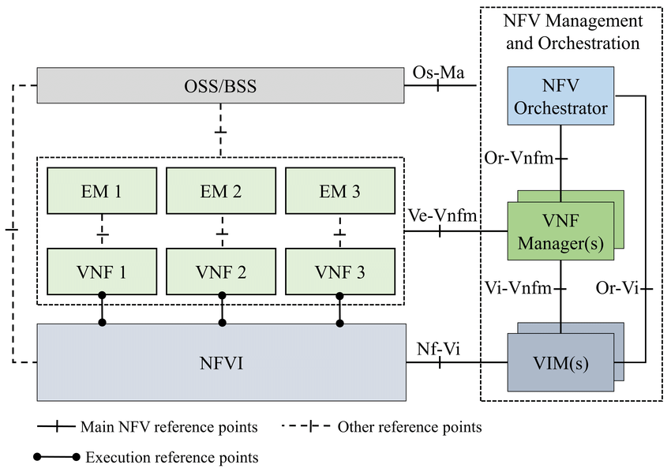
ETSI NFV Architectural Framework
Notes:
EM : Element Management System
Virtual Network Function (VNF)
Virtualized Infrastructure Manager (VIM)

Slide 10
NFV MANAGEMENT AND ORCHESTRATION

Slide 11
ETSI NFV Architectural Framework

Slide 12
NFV Reference Points
NFV Orchestrator
The central brain and automation engine in an NFV architecture.
Primary role: manage the end-to-end lifecycle of Network Services (chains of Virtualized Network Functions (VNFs)) by coordinating resources and processes across the entire NFV infrastructure.

Slide 13
NFV Reference Points
NFV Orchestrator
Key Responsibilities and Functionalities
1- Network Service Lifecycle Management (core function)
  Instantiation: reads a blueprint (Network Service Descriptor) and automatically coordinates with the VNF Manager(s) and VIM to create, connect, and launch all the VNFs in the correct order.
  Scaling: can automatically scale a service in or out based on policies and traffic demands (e.g., adding more virtual firewall instances during peak load).
  Healing: If a service fails, it can initiate recovery actions, like restarting a VNF or moving it to a healthy server.
  Update/Upgrade: It manages coordinated software upgrades for the entire service without causing downtime.
  Termination: It cleanly shuts down and decommissions the entire service, freeing up all resources.

Slide 14
NFV Reference Points
NFV Orchestrator
Key Responsibilities and Functionalities
2- Resource Orchestration & Global Inventory
  Maintains a global view of all available resources (compute, storage, network) across multiple data centers and cloud sites by talking to one or more VIMs.
  It makes intelligent placement decisions for VNFs based on policies
    "place this VNF in the data center closest to the user" or "ensure these two VNFs are on separate physical servers for redundancy".
3- Policy Management and Enforcement
  Implements high-level business and operational policies, such as Service Level Agreements (SLAs), security rules, and affinity/anti-affinity rules
    "these VNFs must not run on the same physical host”.

Slide 15
NFV Reference Points
NFV Orchestrator
Key Responsibilities and Functionalities
4- Service Catalog Management
  Maintains a catalog of available VNFs and pre-defined Network Service blueprints, which are templates that define the service's structure, dependencies, and resource requirements.
5- Interaction with OSS/BSS
  Provides a northbound interface for the traditional OSS/BSS.
    When the OSS requests a new service for a customer, the NFVO receives that request and executes the complex orchestration process to deliver it.
Notes:
Business Support System — BSS
Operations Support System (OSS)

Slide 16
Service Catalog Management in Action
Catalog Contents:
  The Service Catalog contains a list of all available VNFs and Network Services, such as:
    Virtual EPC (vEPC)
    Virtual IMS (vIMS)
    Virtual Firewall (vFW)
    Load Balancer (vLB)
    Network Slice Template for 5G services
Blueprints:
  Each service has a blueprint (template) that defines:
    Structure: What VNFs are included (e.g., vMME, vSGW, vPGW for EPC)
    Dependencies: Which functions depend on others
    Resources: Required CPU, memory, and bandwidth
    Configuration: Network topology and interfaces
Use Case:
  When Vodafone launches a new 5G enterprise service for a client:
    The orchestrator selects the appropriate Network Service Blueprint (e.g., “5G Slice for IoT”).
    The blueprint automatically triggers deployment of all required VNFs (firewall, load balancer, EPC components) from the catalog.
    This ensures a consistent, tested configuration is used across all deployments.
Benefits:
  Reduces service deployment time from weeks to minutes.
  Ensures standardization of network services.
  Supports multi-vendor VNFs seamlessly.

Slide 17
Interaction with OSS/BSS
Customer Service Request (BSS):
  A customer (for example, a business client) orders a VPN or a 5G enterprise slice through AT&T’s customer portal (part of the Business Support System — BSS).
  The BSS sends a service order request to the OSS.
Service Order (OSS → NFVO):
  The Operations Support System (OSS) translates the service order into technical service parameters (e.g., bandwidth, latency, location).
  OSS sends this information to the NFV Orchestrator (NFVO) using the northbound interface.
Orchestration (NFVO):
  The NFVO triggers the orchestration process:
    Selects a Network Service Blueprint from the Service Catalog (e.g., a VPN or 5G slice template).
    Allocates compute, storage, and network resources from the NFV Infrastructure (NFVI).
    Deploys and configures the required VNFs (e.g., virtual routers, firewalls, gateways).
Status & Feedback:
  The NFVO sends status updates (success, error, progress) back to the OSS/BSS.
  Once deployment completes, the OSS updates the customer account and activates billing automatically through the BSS.
Benefits
Automated end-to-end service delivery — no manual provisioning needed.
Seamless integration between customer-facing systems (BSS) and network control (NFVO).
Improved time-to-market for new telecom services (from weeks to minutes).

Slide 18
ETSI NFV Architectural Framework

Slide 19
NFV Reference Points
VNF Manager (VNFM)
Responsible for the lifecycle management of individual instances of Virtualized Network Functions (VNFs).
In simpler terms, if the NFV Orchestrator (NFVO) is the conductor of the entire orchestra (managing the full network service), the VNFM is the section leader for a specific group of instruments

Slide 20
NFV Reference Points
VNF Manager (VNFM)
Key Responsibilities and Functionalities
1- VNF Instance Lifecycle Management
  Instantiation: receives a request from the NFVO and executes the steps to create and boot a new VNF instance (e.g., a virtual firewall).
  This often involves interacting with the VIM to allocate resources.
  Scaling: performs the scaling actions (scale-in/out, scale-up/down) on a VNF based on triggers from the NFVO or directly from the VNF/EMS.
    For example: it can add a new virtual CPU to a VNF (scale-up) or deploy a new instance of the VNF (scale-out)
  Healing: monitors the health of the VNF and can take corrective action if it fails
    For example: restarting the VNF software or rebuilding the VNF on a new host.
  Update/Upgrade: manages the process of updating or patching the VNF's software.
  Termination: gracefully shuts down and deletes the VNF instance, ensuring all resources are released.

Slide 21
NFV Reference Points
VNF Manager (VNFM)
Key Responsibilities and Functionalities
2- Configuration and Event Reporting
  Handle the initial configuration of the VNF after it's instantiated.
  Collects performance measurements (PM) and fault information from the VNF and its underlying virtual resources, forwarding relevant events and data to the NFVO.
3- Policy Enforcement for a VNF
  The VNFM enforces lifecycle management policies specific to a VNF.
    For example, if a policy states, "If CPU usage > 80% for 5 minutes, scale out," the VNFM is the component that executes that scaling action.

Slide 22
NFV Reference Points
VNF Manager (VNFM)
Key Responsibilities and Functionalities
4- Interaction with the VNF and its EMS
  Communicates with the VNF's built-in management system or its traditional Element Management System (EMS) to perform configuration and receive VNF-specific alarms and metrics

Slide 23
ETSI NFV Architectural Framework

Slide 24
NFV Reference Points
Virtualized Infrastructure Manager (VIM)
Responsible for controlling and managing the NFV Infrastructure (NFVI)—the compute, storage, and networking resources that form the cloud platform upon which VNFs run.
So, if the NFVI is the physical data center (servers, disks, switches) and its virtualization layer, the VIM is the operating system and resource manager for that data center.

Slide 25
NFV Reference Points
Virtualized Infrastructure Manager (VIM)
Key Responsibilities and Functionalities
1- Resource Management and Inventory
  Discovery and Inventory: maintains a real-time inventory of all physical and virtual resources under its control
    How many CPU cores, how much RAM, available storage capacity, and network topology.
  Allocation and Scheduling: responsible for allocating specific compute, storage, and network resources to VNFs upon request from the VNFM or NFVO.
    Decides which physical server will host a new VNF instance.

Slide 26
NFV Reference Points
Virtualized Infrastructure Manager (VIM)
Key Responsibilities and Functionalities
2- Orchestration of Virtual Resources
  Doesn't just allocate resources in isolation; it orchestrates them to create complex virtual environments. This includes:
    Creating and managing Virtual Machines (VMs) or containers.
    Creating and connecting virtual networks (e.g., VLANs, VxLANs).
    Attaching virtual storage volumes to VMs.

Slide 27
NFV Reference Points
Virtualized Infrastructure Manager (VIM)
Key Responsibilities and Functionalities
3- Infrastructure Performance and Fault Management
Continuously monitors the health and performance of the NFVI.
Collects metrics like physical server CPU utilization, hypervisor performance, network port statistics, and storage I/O.
Detects hardware and hypervisor failures (e.g., a server power supply failure, a disk array error) and generates alerts.

Slide 28
NFV Reference Points
Virtualized Infrastructure Manager (VIM)
Key Responsibilities and Functionalities
4- Image Management
Stores and manages the software images (e.g., QCOW2, VMDK files) that are used to boot VNFs. When a VNF needs to be instantiated, the VIM retrieves the correct image and uses it to create the VM.
5- Implementation of Network Policies
The VIM enforces low-level network connectivity and security policies defined by higher-level orchestrators. For example, it configures the virtual switches to ensure that the "WAN" port of a virtual firewall is connected to the external network and the "LAN" port is connected to the internal service network.

Slide 29
NFV Reference Points
Virtualized Infrastructure Manager (VIM)
VIMs are essentially cloud management platforms. The most common examples are:
OpenStack (and its components like Nova, Neutron, Cinder)
VMware vCloud Director or the vCenter Server suite
Kubernetes (when managing container-based VNFs)
Public Cloud APIs (e.g., from AWS, Microsoft Azure, Google Cloud)

Slide 30
ETSI NFV Architectural Framework

Slide 31
NFV Reference Points
NFV Infrastructure (NFVI)
Foundational layer of hardware and software resources that provides the virtualized environment upon which Virtualized Network Functions (VNFs) are deployed and run.
It is the "cloud" in the telecom network, abstracting physical resources to create a flexible, on-demand pool of compute, storage, and networking.
So, if VNFs are the apps on your smartphone, the NFVI is the smartphone itself

Slide 32
NFV Reference Points
NFV Infrastructure (NFVI)
NFVI is composed of two essential layers that work together:
1. Physical Layer (Physical Resources)
Compute Hardware: High-volume servers (often using Commercial Off-The-Shelf - COTS - hardware) that provide the processing power (CPUs).
Storage Hardware: Hard disk drives (HDDs), solid-state drives (SSDs), and storage area networks (SANs) that provide capacity for VNF images and data.
Networking Hardware: Physical switches, routers, and network interface cards (NICs) that interconnect the servers and provide links to the external network.
2. Virtualization Layer (Virtualization Software)
Hypervisor or Virtual Machine Monitor (VMM), such as: KVM, VMware ESXi, runs on the physical servers and is responsible for creating and running the Virtual Machines (VMs) or containers that host the VNFs.
It allocates physical resources (CPU, RAM) to these VMs.
Notes:
ESXi: Elastic Sky X Integrated.

Slide 33
NFV Reference Points
NFV Infrastructure (NFVI)
Key Responsibilities and Characteristics
Resource Pooling: Aggregates all physical resources into a shared pool that can be dynamically allocated to any VNF as needed.
Abstraction: Hides the complexity and specifics of the underlying hardware from the VNFs. A VNF doesn't need to know what brand of server it's running on; it just sees the virtual resources (vCPU, vRAM, vNIC) it has been assigned.
Elasticity: The infrastructure can scale resources up and down on demand, allowing VNFs to be scaled seamlessly to handle changing traffic loads.
Isolation: Ensures that multiple VNFs from different vendors or services can run securely side-by-side on the same physical hardware without interfering with each other.

Slide 34
ETSI NFV Architectural Framework

Slide 35
OSS
Operational Support System

Slide 36
ETSI NFV Architectural Framework
OSS
  The "brain" that tells the equipment what to do and ensures everything is running smoothly (manage, monitor, analyze, and control the network operations).
Key functions
  Network Inventory: Keeping a detailed record of every piece of physical and logical network equipment.
  Fault Management: Continuously monitoring the network for failures (e.g., a fiber cut, a router crash, a failing circuit).
  Configuration Management: Remotely configuring network devices (e.g., setting up a new customer's internet connection, updating software on a cell tower).
  Performance Management: Collecting and analyzing performance data (e.g., bandwidth utilization, latency, packet loss, signal strength).
  Service Provisioning & Activation: The process of automatically setting up and activating a new service for a customer (e.g., activating a new fiber line or a 5G mobile plan).
Notes:
Network Inventory: Keeping a detailed record of every piece of physical and logical network equipment (e.g., which router is where, what cards are in it, which ports are used, what services are running on them).
Fault Management: Continuously monitoring the network for failures (e.g., a fiber cut, a router crash, a failing circuit). It collects alarms, identifies the root cause, and helps technicians dispatch repairs.
Configuration Management: Remotely configuring network devices (e.g., setting up a new customer's internet connection, updating software on a cell tower).
Performance Management: Collecting and analyzing performance data (e.g., bandwidth utilization, latency, packet loss, signal strength) to ensure the network meets quality standards.
Service Provisioning & Activation: The process of automatically setting up and activating a new service for a customer (e.g., activating a new fiber line or a 5G mobile plan).
Real-World Example: Activating a New Home Fiber Internet Customer
Let's follow the journey of a new customer, "Alex," who orders a 1 Gbps fiber internet package from "Telecom Giant Inc." The OSS platforms work behind the scenes to make this happen.
Step 1: Order Receipt and Service Design
Alex places an order online. This order enters Telecom Giant's Business Support System (BSS)—the system that handles customer-facing processes like orders, billing, and CRM.
The BSS sends a request to the OSS: "Please provision a 1 Gbps internet service for Alex at 123 Main St."
Step 2: Network Inventory Check (OSS Function)
The Network Inventory Management System (a core OSS component) receives the request.
It queries its database to answer critical questions:
Is there a free port on the Optical Line Terminal (OLT) at the street cabinet near 123 Main St.?
Is there a spare fiber strand running from that port to Alex's house?
What is the unique identifier for the ONT (Optical Network Terminal) device that will be installed in Alex's home?
The inventory system reserves these resources to prevent another order from using them.
Step 3: Service Provisioning & Activation (OSS Function)
The Service Fulfillment / Provisioning System (another OSS component) takes over.
It automatically sends configuration commands to the network devices:
It configures the OLT port to recognize the unique serial number of Alex's ONT.
It sets the bandwidth profile on the OLT and the core router to 1 Gbps for that specific port.
It establishes the connection from Alex's future ONT, through the aggregation network, to the Broadband Network Gateway (BNG) in the core network, which assigns an IP address.
Step 4: Work Order Dispatch
The OSS generates a work order for a field technician and dispatches it to their mobile device. The work order, derived from the inventory system, tells the technician exactly which ONT device to install and which port on the street cabinet to plug the fiber into.
Step 5: Installation and Activation
The technician installs the ONT at Alex's home and plugs in the fiber.
The ONT "lights up" and authenticates with the OLT. Because the OSS pre-configured everything, the connection is established instantly.
Alex can now connect to the internet.
Step 6: Ongoing Monitoring & Assurance (OSS Function)
Now that Alex is a customer, the Network Monitoring and Fault Management System (an OSS) begins watching his service.
It collects performance metrics from the ONT and OLT: optical signal strength, data usage, error rates.
If the fiber line gets damaged a week later, causing Alex's signal to drop, this system immediately generates an alarm. It correlates the alarm, identifies that the issue is likely a physical break between the cabinet and Alex's house, and automatically creates a repair ticket for a technician.

Slide 37
ETSI NFV Architectural Framework
OSS Example (Activating a New Home Fiber Internet Customer)
Alex," who orders a 1 Gbps fiber internet package from "Telecom Giant Inc." The OSS platforms work behind the scenes to make this happen
  Step 1: Order Receipt and Service Design
  Step 2: Network Inventory Check (OSS Function)
  Step 3: Service Provisioning & Activation (OSS Function)
  Step 4: Work Order Dispatch
  Step 5: Installation and Activation
  Step 6: Ongoing Monitoring & Assurance (OSS Function)
Notes:
Network Inventory: Keeping a detailed record of every piece of physical and logical network equipment (e.g., which router is where, what cards are in it, which ports are used, what services are running on them).
Fault Management: Continuously monitoring the network for failures (e.g., a fiber cut, a router crash, a failing circuit). It collects alarms, identifies the root cause, and helps technicians dispatch repairs.
Configuration Management: Remotely configuring network devices (e.g., setting up a new customer's internet connection, updating software on a cell tower).
Performance Management: Collecting and analyzing performance data (e.g., bandwidth utilization, latency, packet loss, signal strength) to ensure the network meets quality standards.
Service Provisioning & Activation: The process of automatically setting up and activating a new service for a customer (e.g., activating a new fiber line or a 5G mobile plan).
Real-World Example: Activating a New Home Fiber Internet Customer
Let's follow the journey of a new customer, "Alex," who orders a 1 Gbps fiber internet package from "Telecom Giant Inc." The OSS platforms work behind the scenes to make this happen.
Step 1: Order Receipt and Service Design
Alex places an order online. This order enters Telecom Giant's Business Support System (BSS)—the system that handles customer-facing processes like orders, billing, and CRM.
The BSS sends a request to the OSS: "Please provision a 1 Gbps internet service for Alex at 123 Main St."
Step 2: Network Inventory Check (OSS Function)
The Network Inventory Management System (a core OSS component) receives the request.
It queries its database to answer critical questions:
Is there a free port on the Optical Line Terminal (OLT) at the street cabinet near 123 Main St.?
Is there a spare fiber strand running from that port to Alex's house?
What is the unique identifier for the ONT (Optical Network Terminal) device that will be installed in Alex's home?
The inventory system reserves these resources to prevent another order from using them.
Step 3: Service Provisioning & Activation (OSS Function)
The Service Fulfillment / Provisioning System (another OSS component) takes over.
It automatically sends configuration commands to the network devices:
It configures the OLT port to recognize the unique serial number of Alex's ONT.
It sets the bandwidth profile on the OLT and the core router to 1 Gbps for that specific port.
It establishes the connection from Alex's future ONT, through the aggregation network, to the Broadband Network Gateway (BNG) in the core network, which assigns an IP address.
Step 4: Work Order Dispatch
The OSS generates a work order for a field technician and dispatches it to their mobile device. The work order, derived from the inventory system, tells the technician exactly which ONT device to install and which port on the street cabinet to plug the fiber into.
Step 5: Installation and Activation
The technician installs the ONT at Alex's home and plugs in the fiber.
The ONT "lights up" and authenticates with the OLT. Because the OSS pre-configured everything, the connection is established instantly.
Alex can now connect to the internet.
Step 6: Ongoing Monitoring & Assurance (OSS Function)
Now that Alex is a customer, the Network Monitoring and Fault Management System (an OSS) begins watching his service.
It collects performance metrics from the ONT and OLT: optical signal strength, data usage, error rates.
If the fiber line gets damaged a week later, causing Alex's signal to drop, this system immediately generates an alarm. It correlates the alarm, identifies that the issue is likely a physical break between the cabinet and Alex's house, and automatically creates a repair ticket for a technician.

Slide 38
ETSI NFV Architectural Framework

Slide 39
BSS
Business Support System

Slide 40
ETSI NFV Architectural Framework
BSS
  Describe the business and/or customer-facing functionality.
Key functions
  Customer Relationship Management (CRM): The single view of the customer, managing all interactions, sales history, and contact information.
  Order Management: Capturing and managing the customer's order for a new service, upgrade, or change.
  Billing and Revenue Management: Generating invoices, processing payments, applying discounts...
  Product Catalog: Defining the sellable products and services (e.g., "1 Gbps Internet," "Unlimited Mobile Plan," "Streaming TV Bundle") and their rules.
  Fulfillment Orchestration: Taking the customer's order and triggering the correct processes in the OSS to have the service delivered.
Notes:
BSS
Key functions of a BSS typically include:
Customer Relationship Management (CRM): The single view of the customer, managing all interactions, sales history, and contact information.
Order Management: Capturing and managing the customer's order for a new service, upgrade, or change.
Billing and Revenue Management: Generating invoices, processing payments, applying discounts, and managing complex rating for usage (e.g., data overages, international calls).
Product Catalog: Defining the sellable products and services (e.g., "1 Gbps Internet," "Unlimited Mobile Plan," "Streaming TV Bundle") and their rules.
Fulfillment Orchestration: Taking the customer's order and triggering the correct processes in the OSS to have the service delivered.
Real-World Example: The Same Home Fiber Internet Customer
Let's revisit our customer, "Alex," ordering from "Telecom Giant Inc." We'll now see the crucial role the BSS plays in his journey.
Step 1: Product Discovery & Shopping Cart (BSS Function)
Alex visits Telecom Giant's website. The prices, packages, and promotional offers (e.g., "First 3 months at $50/month") he sees are all managed in the Product Catalog within the BSS.
When Alex selects the 1 Gbps internet plan and clicks "Order Now," the BSS's Order Managementsystem captures his selection and creates a "shopping cart."
Step 2: Customer Creation & Credit Check (BSS Function)
Alex enters his personal details: name, address, Social Security Number for a credit check, and contact information.
The CRM system creates a new customer account for Alex.
The BSS interfaces with an external credit agency to perform a credit check. Based on the result, the system might approve the order or require a deposit.
Step 3: Order Submission & Orchestration (BSS & OSS Handshake)
Alex submits the order. This is a critical handoff point.
The BSS Order Management system receives the complete order. It doesn't know how to configure a router, but it knows what service the customer bought.
It translates the business order ("1 Gbps Internet for Alex") into a technical service request and sends it to the OSS (specifically, to the OSS's service provisioning system) to be fulfilled.
The BSS order status now shows "In Progress."
Step 4: Billing Cycle Activation (BSS Function)
Once the BSS receives a confirmation from the OSS that the service has been successfully provisioned and activated (see the OSS example), a crucial BSS action is triggered.
The Billing System is notified: "Alex's service is now live."
The billing system:
Creates a new billing account for Alex.
Starts the billing cycle.
Schedules the first invoice to be generated.
Step 5: Invoicing and Payment (BSS Function)
At the end of the billing cycle, the Billing System generates an invoice. It pulls data from various sources:
The Product Catalog for the recurring monthly charge of $79.99.
The OSS (if applicable) for any usage-based charges (this is more common for mobile data).
It applies the promotional discount for the first three months.
The invoice is sent to Alex via email or post.
When Alex pays online, the payment is processed and recorded by the BSS's Revenue Managementsystem.
Step 6: Ongoing Customer Support & Retention (BSS Function)
If Alex calls customer service because he's moving, the agent uses the CRM to see his entire history and create a "Change of Address" order.
If Alex complains about his bill, the agent can use the BSS to issue a credit or explain charges.
If Alex tries to cancel his service, the retention team uses the BSS to see his value as a customer and may offer a new promotion from the Product Catalog to keep him.

Slide 41
ETSI NFV Architectural Framework
BSS example (The Same Home Fiber Internet Customer)
Let's revisit our customer, "Alex," ordering from "Telecom Giant Inc." We'll now see the crucial role the BSS plays in his journey.
  Step 1: Product Discovery & Shopping Cart (BSS Function)
  Step 2: Customer Creation & Credit Check (BSS Function)
  Step 3: Order Submission & Orchestration (BSS & OSS Handshake)
  Step 4: Billing Cycle Activation (BSS Function)
  Step 5: Invoicing and Payment (BSS Function)
  Step 6: Ongoing Customer Support & Retention (BSS Function)
Notes:
BSS
Key functions of a BSS typically include:
Customer Relationship Management (CRM): The single view of the customer, managing all interactions, sales history, and contact information.
Order Management: Capturing and managing the customer's order for a new service, upgrade, or change.
Billing and Revenue Management: Generating invoices, processing payments, applying discounts, and managing complex rating for usage (e.g., data overages, international calls).
Product Catalog: Defining the sellable products and services (e.g., "1 Gbps Internet," "Unlimited Mobile Plan," "Streaming TV Bundle") and their rules.
Fulfillment Orchestration: Taking the customer's order and triggering the correct processes in the OSS to have the service delivered.
Real-World Example: The Same Home Fiber Internet Customer
Let's revisit our customer, "Alex," ordering from "Telecom Giant Inc." We'll now see the crucial role the BSS plays in his journey.
Step 1: Product Discovery & Shopping Cart (BSS Function)
Alex visits Telecom Giant's website. The prices, packages, and promotional offers (e.g., "First 3 months at $50/month") he sees are all managed in the Product Catalog within the BSS.
When Alex selects the 1 Gbps internet plan and clicks "Order Now," the BSS's Order Managementsystem captures his selection and creates a "shopping cart."
Step 2: Customer Creation & Credit Check (BSS Function)
Alex enters his personal details: name, address, Social Security Number for a credit check, and contact information.
The CRM system creates a new customer account for Alex.
The BSS interfaces with an external credit agency to perform a credit check. Based on the result, the system might approve the order or require a deposit.
Step 3: Order Submission & Orchestration (BSS & OSS Handshake)
Alex submits the order. This is a critical handoff point.
The BSS Order Management system receives the complete order. It doesn't know how to configure a router, but it knows what service the customer bought.
It translates the business order ("1 Gbps Internet for Alex") into a technical service request and sends it to the OSS (specifically, to the OSS's service provisioning system) to be fulfilled.
The BSS order status now shows "In Progress."
Step 4: Billing Cycle Activation (BSS Function)
Once the BSS receives a confirmation from the OSS that the service has been successfully provisioned and activated (see the OSS example), a crucial BSS action is triggered.
The Billing System is notified: "Alex's service is now live."
The billing system:
Creates a new billing account for Alex.
Starts the billing cycle.
Schedules the first invoice to be generated.
Step 5: Invoicing and Payment (BSS Function)
At the end of the billing cycle, the Billing System generates an invoice. It pulls data from various sources:
The Product Catalog for the recurring monthly charge of $79.99.
The OSS (if applicable) for any usage-based charges (this is more common for mobile data).
It applies the promotional discount for the first three months.
The invoice is sent to Alex via email or post.
When Alex pays online, the payment is processed and recorded by the BSS's Revenue Managementsystem.
Step 6: Ongoing Customer Support & Retention (BSS Function)
If Alex calls customer service because he's moving, the agent uses the CRM to see his entire history and create a "Change of Address" order.
If Alex complains about his bill, the agent can use the BSS to issue a credit or explain charges.
If Alex tries to cancel his service, the retention team uses the BSS to see his value as a customer and may offer a new promotion from the Product Catalog to keep him.

Slide 42
ETSI NFV Architectural Framework

Slide 43
EMS
Element Management System

Slide 44
ETSI NFV Architectural Framework
EMS
  Manages specific types of one or more network elements within a telecommunication management network (TMN).
  Manage functions and capabilities.
  Communicates upward to higher-level systems of network management (NMS), in order to manage the traffic between itself and other network elements.
Key functions
  Device-Level Fault Management: Receiving real-time alarms and events from a specific device (e.g., "Port 5 Failure," "CPU Overload," "Transmitter Laser Fault").
  Device Configuration: Directly configuring settings on the device (e.g., setting up VLANs, adjusting radio power, provisioning a port speed).
  Performance Monitoring: Collecting detailed performance metrics from the device (e.g., bytes in/out on an interface, optical power levels, error counts, memory utilization).
  Software/Firmware Management: Pushing software updates and patches to the devices it manages.
  Log Management: Collecting and storing logs from the device for audit and debugging purposes.
Notes:
What is an EMS? (Deep Dive)
An Element Management System (EMS) is a software system that is responsible for managing one or more specific types of network elements (devices) from a single vendor or technology domain.
An EMS provides the direct, hands-on control and visibility into the hardware. It is the specialized tool that network operators use to configure, monitor, and troubleshoot the actual "boxes" in the network, like routers, switches, optical transceivers, or cell tower radios.
Key functions of an EMS typically include:
Device-Level Fault Management: Receiving real-time alarms and events from a specific device (e.g., "Port 5 Failure," "CPU Overload," "Transmitter Laser Fault").
Device Configuration: Directly configuring settings on the device (e.g., setting up VLANs, adjusting radio power, provisioning a port speed).
Performance Monitoring: Collecting detailed performance metrics from the device (e.g., bytes in/out on an interface, optical power levels, error counts, memory utilization).
Software/Firmware Management: Pushing software updates and patches to the devices it manages.
Log Management: Collecting and storing logs from the device for audit and debugging purposes.
Real-World Example: Troubleshooting a Network Slowdown in a Specific Area
Let's return to "Telecom Giant Inc." The NOC (Network Operations Center) gets several calls from businesses in a downtown office building complaining that their internet is slow.
Step 1: The OSS Raises the Alert
The OSS Network Monitoring System detects a performance degradation affecting the service for customers connected through the aggregation router located in the "Main St. Central Office."
The OSS dashboard shows a service-level alarm: "Performance Degradation - Main St. Central Office." It knows that there is a problem and where it is roughly located, but it doesn't necessarily know the exact root cause inside the device.
Step 2: Drilling Down with the EMS
A network engineer opens the specific EMS for the "NetGiant 9000" series routers (the vendor and model of the problematic router).
While the OSS monitors the service, the EMS monitors the device. The engineer now has a detailed, device-specific view.
Step 3: Identifying the Root Cause (EMS Function)
Inside the EMS, the engineer can see:
Performance Data: The EMS shows that the GigabitEthernet0/1 interface on the router has been running at 98% utilization for the last 2 hours, which is the cause of the congestion and slow speeds.
Fault Data: The EMS alarm log shows a related, minor alarm that the OSS might have filtered: "Interface Consistent Over-Utilization on GigabitEthernet0/1".
Configuration Data: The EMS displays the current configuration of that interface, showing it's a 1 Gbps link.
Step 4: Taking Action via the EMS
The engineer uses the EMS's configuration tools to investigate the traffic.
She sees that a single tenant in the building is running a massive data backup, consuming most of the link's capacity.
Using the EMS, she applies a temporary Quality of Service (QoS) policy to the interface, limiting the bandwidth for that type of backup traffic and ensuring fair access for all other users. She does this directly through the EMS's interface, which generates the correct command-line instructions for the router.
Step 5: Proactive Maintenance with the EMS
The root cause is a need for a network upgrade. The engineer uses the EMS for other tasks:
Inventory: The EMS confirms the exact hardware model of the router and what free slots it has.
Software Upgrade: She uses the EMS to schedule and push a new software version to the router during a maintenance window to improve its traffic handling.
Configuration Backup: Before the upgrade, the EMS automatically performs a backup of the router's full configuration.

Slide 45
ETSI NFV Architectural Framework
EMS example (Troubleshooting a Network Slowdown in a Specific Area)
Let's return to "Telecom Giant Inc." The NOC (Network Operations Center) gets several calls from businesses in a downtown office building complaining that their internet is slow.
  Step 1: The OSS Raises the Alert
  Step 2: Drilling Down with the EMS
  Step 3: Identifying the Root Cause (EMS Function)
    Performance Data, Fault Data, and Configuration Data
  Step 4: Taking Action via the EMS
    Apply temporary Quality of Service (QoS) policy
  Step 5: Proactive Maintenance with the EMS
    Inventory, Software Upgrade, and Configuration Backup.
Notes:
Real-World Example: Troubleshooting a Network Slowdown in a Specific Area
Let's return to "Telecom Giant Inc." The NOC (Network Operations Center) gets several calls from businesses in a downtown office building complaining that their internet is slow.
Step 1: The OSS Raises the Alert
The OSS Network Monitoring System detects a performance degradation affecting the service for customers connected through the aggregation router located in the "Main St. Central Office."
The OSS dashboard shows a service-level alarm: "Performance Degradation - Main St. Central Office." It knows that there is a problem and where it is roughly located, but it doesn't necessarily know the exact root cause inside the device.
Step 2: Drilling Down with the EMS
A network engineer opens the specific EMS for the "NetGiant 9000" series routers (the vendor and model of the problematic router).
While the OSS monitors the service, the EMS monitors the device. The engineer now has a detailed, device-specific view.
Step 3: Identifying the Root Cause (EMS Function)
Inside the EMS, the engineer can see:
Performance Data: The EMS shows that the GigabitEthernet0/1 interface on the router has been running at 98% utilization for the last 2 hours, which is the cause of the congestion and slow speeds.
Fault Data: The EMS alarm log shows a related, minor alarm that the OSS might have filtered: "Interface Consistent Over-Utilization on GigabitEthernet0/1".
Configuration Data: The EMS displays the current configuration of that interface, showing it's a 1 Gbps link.
Step 4: Taking Action via the EMS
The engineer uses the EMS's configuration tools to investigate the traffic.
She sees that a single tenant in the building is running a massive data backup, consuming most of the link's capacity.
Using the EMS, she applies a temporary Quality of Service (QoS) policy to the interface, limiting the bandwidth for that type of backup traffic and ensuring fair access for all other users. She does this directly through the EMS's interface, which generates the correct command-line instructions for the router.
Step 5: Proactive Maintenance with the EMS
The root cause is a need for a network upgrade. The engineer uses the EMS for other tasks:
Inventory: The EMS confirms the exact hardware model of the router and what free slots it has.
Software Upgrade: She uses the EMS to schedule and push a new software version to the router during a maintenance window to improve its traffic handling.
Configuration Backup: Before the upgrade, the EMS automatically performs a backup of the router's full configuration.

Slide 46
ETSI NFV Architectural Framework
Think of it in terms of hierarchy:
BSS manages the customer and the business.
OSS manages the end-to-end services and network-wide operations.
EMS manages individual devices or a group of similar devices.

Slide 47
Standardized interfaces between the functional blocks in the ETSI NFV framework

Slide 48
NFV Reference Points
Orchestrator – VNF Manager (Or-Vnfm)
Main Functionalities:
VNF Instantiation Request: The NFVO instructs the VNFM to instantiate (create) a new VNF instance.
VNF Lifecycle Management Commands: The NFVO can request the VNFM to perform actions like scale (in/out, up/down), heal (e.g., restart a failed VNF component), update/upgrade, or terminate a VNF.
VNF Lifecycle Change Notification: The VNFM informs the NFVO about changes in the VNF's state (e.g., "VNF instantiation is complete," "Scaling operation failed," "VNF is now terminated").
Policy Enforcement: The NFVO can provide the VNFM with policies related to the VNF's lifecycle (e.g., "Scale out when CPU usage > 80%").

Slide 49
NFV Reference Points
Virtualized Infrastructure Manager – VNF Manager (Vi-Vnfm)
Main Functionalities:
Resource Allocation for VNF Lifecycle: When the VNFM needs to instantiate or scale a VNF, it uses this interface to ask the VIM to allocate the actual compute, storage, and network resources.
Performance & Fault Information: The VNFM can query the VIM for performance data (e.g., CPU utilization of the VM hosting the VNF) and fault information (e.g., "The underlying VM has crashed") to make healing and scaling decisions.
Virtualized Resource Change Notification: The VIM can notify the VNFM about events related to the resources a VNF is using (e.g., a hypervisor evacuation).

Slide 50
NFV Reference Points
Orchestrator – Virtualized Infrastructure Manager (Or-Vi)
Main Functionalities:
Resource Reservation & Allocation: The NFVO uses this interface to reserve and allocate blocks of resources from the VIM to fulfill Network Services.
Global Resource Inventory: The NFVO queries the VIM to discover the available capacity and inventory of the entire NFVI (e.g., how many total CPU cores are free, what networks are available). This is essential for placement decisions.
Infrastructure Performance and Fault Management: The NFVO receives aggregated performance and fault information about the NFVI from the VIM (e.g., "Datacenter 'A' is over-utilized," "Physical server 'X' has failed").
Root Cause Analysis: By correlating VIM-level faults with service-level issues, the NFVO can determine if a service failure is due to a VNF software bug or an underlying hardware failure.

Slide 51
NFV Reference Points
NFVI-Virtualized Infrastructure Manager (Nf-Vi)
Main Functionalities:
Hardware Resource Abstraction: The VIM uses this interface to communicate with the hypervisors (e.g., KVM, VMware) and physical hardware to actually create, delete, and manage virtual machines (VMs) and containers.
Physical Resource Inventory: The VIM discovers the physical compute, storage, and networking hardware via this interface.
Hardware-Level Fault and Performance Management: The hypervisors and hardware drivers send real-time performance metrics (CPU, memory, I/O) and fault alerts (hard disk failure, network link down) up to the VIM through this interface.

Slide 52
NFV Reference Points
Operation Support System (OSS)/Business Support Systems (BSS) – NFV Management and Orchestration (Os-Ma)
Main Functionalities:
Network Service Lifecycle Management: The OSS uses this interface to request the NFVO to instantiate, scale, update, or terminate a complete Network Service (a chain of VNFs).
Policy Exchange: The OSS/BSS provides the NFVO with high-level business and service policies (e.g., service level agreements - SLAs).
Service-Related Information Reporting: The NFVO provides the OSS/BSS with data about the Network Service, including its current state, performance data for SLA reporting, and fault information for ticketing.
Billing Data: Usage records for VNFs and Network Services can be sent to the BSS for billing purposes.

Slide 53
NFV Reference Points
VNF/ Element Management System (EMS) – VNF Manager (Ve-Vnfm)
Main Functionalities:
VNF Configuration: The VNFM can trigger initial configuration on the VNF after instantiation via the EMS.
Software Image Management: The VNFM can instruct the EMS to update the VNF's software.
VNF-Specific Fault and Performance Management: The EMS reports VNF-specific alarms (e.g., "Firewall policy table is full," "Session limit reached") and performance metrics (e.g., "Packets inspected per second") to the VNFM. The VNFM can then decide to trigger a healing or scaling action.
Lifecycle Coordination: The VNFM informs the EMS of impending lifecycle operations (e.g., "I am about to scale this VNF, prepare yourself").

Slide 54
A Simple Analogy: The Power Grid
Let's use a powerful analogy to tie all the NFV components together. Imagine providing electricity to a city.
The NFVI is the entire Power Grid Infrastructure.
  The Physical Layer is the power plants, coal/gas, high-voltage transmission lines, and electrical substations.
  The Virtualization Layer is the technology that converts various energy sources (coal, gas, solar) into a standardized form (AC electricity) and manages its flow.
The VNFs are the Electrical Appliances in homes and businesses (e.g., a refrigerator, an air conditioner, a factory machine). Each appliance provides a specific function.
The VIM is the Local Power Station Manager & Grid Operator.
  They control the flow of electricity from the power plants to the neighborhoods. They can switch power sources and reroute energy to where it's needed most.

Slide 55
A Simple Analogy: The Power Grid (cont)
The VNFM is the Appliance Specialist/Technician.
  If your air conditioner (Firewall VNF) breaks, the technician (VNFM) is called to fix or replace it. If you need more cooling, they install a bigger unit (scale up).
The NFV Orchestrator is the City Planning Department.
  They don't manage individual appliances or power lines. They approve the construction of a new housing development (new Network Service) and ensure that the power grid, water, and roads are coordinated to support it. They work with the Grid Operator (VIM) to ensure capacity is available.

Slide 56
Summary
Module | Real-World Function | Example in the Scenario
OSS/BSS | Handles customer orders, billing, and policy | Customer requests VPN via portal
NFV Orchestrator (NFVO) | Plans and coordinates the full network service | Selects and deploys “Enterprise VPN” blueprint
VNF Manager (VNFM) | Manages the lifecycle of VNFs | Instantiates and configures vRouter, vFirewall, vLoadBalancer
VIM | Allocates compute, storage, and network resources | Deploys VMs and sets up virtual networks
NFVI | Executes VNFs on physical infrastructure | Hosts all VNFs in data centers
EMS | Manages individual VNFs | Configures rules, monitors performance, sends alarms

Slide 57
OSS/BSS — Customer Request and Business Orchestration
Technologies Used:
  BSS: Salesforce CRM, Amdocs, or NetCracker
  OSS: ServiceNow OSS, NetAct
  Interface: Os-Ma (REST API / SOAP over HTTPS)
  Data formats: TMF Open APIs (TMF640 – Service Ordering, TMF641 – Service Inventory)
Notes:
SOAP: Simple Object Access Protocol
REST = Simple, fast, uses JSON, great for modern apps
SOAP over HTTPS = Strict, secure, uses XML, good for banking/government
Both can work over HTTPS, but SOAP has extra security layers
REST is more common today
OS = Operations System (like OSS/BSS)
MA = Management Application (like network management tools)

Slide 58
OSS/BSS — Customer Request and Business Orchestration
  Interface: Os-Ma (REST API / SOAP over HTTPS)
  REST is a style of building web services that uses:
  HTTP methods (GET, POST, PUT, DELETE)
  URLs
  JSON format (sometimes XML)
REST Example:
* Get student with ID 5:
GET https://school-api.com/students/5
* Response (JSON):
{
"id": 5,
"name": "Sara",
"grade": 8
}
Notes:
SOAP: Simple Object Access Protocol
REST = Simple, fast, uses JSON, great for modern apps
SOAP over HTTPS = Strict, secure, uses XML, good for banking/government
Both can work over HTTPS, but SOAP has extra security layers
REST is more common today
OS = Operations System (like OSS/BSS)
MA = Management Application (like network management tools)

Slide 59
OSS/BSS — Customer Request and Business Orchestration
  Interface: Os-Ma (REST API / SOAP over HTTPS)
  SOAP is a strict, formal protocol for exchanging messages using XML.
    More Secure than REST
    Slower and Heavier
SOAP Request Example:
* Get student info:
POST https://school-api.com/studentService
Content-Type: text/xml
* Body (XML):
<soapenv:Envelope xmlns:soapenv="http://schemas.xmlsoap.org/soap/envelope/"
xmlns:stu="http://school.com/student">
<soapenv:Header/>
<soapenv:Body>
<stu:getStudent>
<stu:id>5</stu:id>
</stu:getStudent>
</soapenv:Body>
</soapenv:Envelope>
Notes:
SOAP: Simple Object Access Protocol
REST = Simple, fast, uses JSON, great for modern apps
SOAP over HTTPS = Strict, secure, uses XML, good for banking/government
Both can work over HTTPS, but SOAP has extra security layers
REST is more common today
OS = Operations System (like OSS/BSS)
MA = Management Application (like network management tools)

Slide 60
OSS/BSS — Customer Request and Business Orchestration
  Interface: Os-Ma (REST API / SOAP over HTTPS)
SOAP Response Example:
<soapenv:Envelope xmlns:soapenv="http://schemas.xmlsoap.org/soap/envelope/">
<soapenv:Body>
<getStudentResponse>
<id>5</id>
<name>Sara</name>
<grade>8</grade>
</getStudentResponse>
</soapenv:Body>
</soapenv:Envelope>
Notes:
SOAP: Simple Object Access Protocol
REST = Simple, fast, uses JSON, great for modern apps
SOAP over HTTPS = Strict, secure, uses XML, good for banking/government
Both can work over HTTPS, but SOAP has extra security layers
REST is more common today
OS = Operations System (like OSS/BSS)
MA = Management Application (like network management tools)

Slide 61
OSS/BSS — Customer Request and Business Orchestration
  Data formats: TMF Open APIs
    TMF640 – Service Ordering: used when a customer or another system wants to place, update, or track a service order.
    Submit service orders
    Modify or cancel orders
    Check order status
    Attach service characteristics
    Include related customer and service information
    TMF641 – Service Inventory: returns the list of active, planned, or terminated service instances owned by the customer.
    Query service inventory
    Get detailed service instance information
    Get service hierarchy (parent/child services)
    Track service activation state
    View service characteristics
Notes:
SOAP: Simple Object Access Protocol
REST = Simple, fast, uses JSON, great for modern apps
SOAP over HTTPS = Strict, secure, uses XML, good for banking/government
Both can work over HTTPS, but SOAP has extra security layers
REST is more common today
OS = Operations System (like OSS/BSS)
MA = Management Application (like network management tools)

Slide 62
OSS/BSS — Customer Request and Business Orchestration
  Data formats: TMF Open APIs
{ "externalId": "SO-2025-001",
"description": "Fiber broadband installation",
"requestedStartDate": "2025-11-15T10:00:00Z",
"orderItem": [
{
"id": "1",
"action": "add",
"service": {
"name": "Fiber 100Mbps",
"serviceSpecification": {
"id": "fiber_spec_100",
"href": "/serviceSpecification/fiber_spec_100"},
"serviceCharacteristic": [
{
"name": "Speed",
"value": "100Mbps"},
{
"name": "InstallationType",
"value": "HomeVisit"
}]}}]}
Creating a Service Order (TMF640)
POST /serviceOrder
{
"id": "7890",
"state": "acknowledged",
"orderItem": [
{
"id": "1",
"state": "acknowledged"
}
]
}
Response body
Request body
Notes:
SOAP: Simple Object Access Protocol
REST = Simple, fast, uses JSON, great for modern apps
SOAP over HTTPS = Strict, secure, uses XML, good for banking/government
Both can work over HTTPS, but SOAP has extra security layers
REST is more common today
OS = Operations System (like OSS/BSS)
MA = Management Application (like network management tools)

Slide 63
OSS/BSS — Customer Request and Business Orchestration
[{
"id": "service_001",
"name": "Fiber 100Mbps",
"serviceState": "active",
"serviceSpecification": {
"id": "fiber_spec_100” },
"serviceCharacteristic": [
{
"name": "Speed",
"value": "100Mbps” },
{
"name": "RouterIncluded",
"value": "YES"}]},
{
"id": "service_002",
"name": "Mobile Voice",
"serviceState": "active",
"serviceCharacteristic": [
{
"name": "Minutes",
"value": "300"}]}]
  Data formats: TMF Open APIs
Query Service Inventory (TMF641)
GET /service?serviceState=active
Notes:
SOAP: Simple Object Access Protocol
REST = Simple, fast, uses JSON, great for modern apps
SOAP over HTTPS = Strict, secure, uses XML, good for banking/government
Both can work over HTTPS, but SOAP has extra security layers
REST is more common today
OS = Operations System (like OSS/BSS)
MA = Management Application (like network management tools)

Slide 64
OSS/BSS — Customer Request and Business Orchestration
Technical Steps:
1- Customer order created in BSS (Order Management System) → generates an XML/JSON order message:
{
"serviceType": "5G_Enterprise_VPN",
"bandwidth": "10Gbps",
"QoS": "Gold",
"locations": ["Paris", "London", "Berlin"]
}
2 - BSS → OSS via TMF640 API: triggers “Order Fulfillment.”
3 - OSS translates service request into a Network Service Descriptor (NSD) request to the NFV Orchestrator.
4 - Sends this request to NFVO using the Os-Ma interface:
POST /nfvo/ns-instances
Content-Type: application/json
Output: The NFVO now receives a structured service request ready for orchestration.
Notes:
SOAP: Simple Object Access Protocol
REST = Simple, fast, uses JSON, great for modern apps
SOAP over HTTPS = Strict, secure, uses XML, good for banking/government
Both can work over HTTPS, but SOAP has extra security layers
REST is more common today
OS = Operations System (like OSS/BSS)
MA = Management Application (like network management tools)

Slide 65
NFV Orchestrator (NFVO) — Service Orchestration and Automation
The NFVO receives the VPN request and automatically orchestrates the deployment of all required Virtual Network Functions (VNFs).
Technical Used:
Platform: OSM (Open Source MANO) or ONAP (Open Network Automation Platform)
Interfaces: Or-Vnfm (to VNFM), Or-Vi (to VIM)
Blueprints: Network Service Descriptors (YAML-based NSDs)
Technical Steps:
1- The NFVO reads the NSD named enterprise_vpn.yaml:
nsd:
name: Enterprise_VPN_Service
constituent-vnfd:
- vnfd-id: vRouter
- vnfd-id: vFirewall
- vnfd-id: vLoadBalancer
2- Checks available resources via Or–Vi API to the VIM (e.g., OpenStack Keystone/Nova).
Notes:
YAML is popular because:
✔ Easy to read (looks like simple text)
✔ Uses indentation, not curly braces {} or brackets []
✔ Supports complex data structures
✔ Used for configuration files
✔ Used in DevOps, cloud, APIs, and more
KVM: Kernel-based Virtual Machine.

Slide 66
NFV Orchestrator (NFVO) — Service Orchestration and Automation
Technical Steps:
3- Sends VNF instantiation requests to VNFM via Or–Vnfm:
POST /vnfm/vnfs
{
"vnfd_id": "vFirewall",
"flavor": "medium",
"location": "London"
}
4- NFVO coordinates all VNFs, chaining them (Service Function Chaining) through SDN controllers (e.g., OpenDaylight).
Output: A network service graph is instantiated — VPN tunnel + virtual firewall + load balancer.
Notes:
YAML is popular because:
✔ Easy to read (looks like simple text)
✔ Uses indentation, not curly braces {} or brackets []
✔ Supports complex data structures
✔ Used for configuration files
✔ Used in DevOps, cloud, APIs, and more

Slide 67
NFV Manager (NFVM) — Lifecycle and Policy Control
The VNFM manages the lifecycle of the deployed VNFs — creating, configuring, monitoring, and scaling them.
Technical Used:
VNFM Platform: Nokia CloudBand, Huawei CloudMSE, or OSM VNFM
Interface: Ve–Vnfm (to EMS), Vi–Vnfm (to VIM)
Protocols: NETCONF/YANG, RESTCONF, Ansible automation scripts
Technical Steps:
1- VNFM receives instantiateVNFRequest from NFVO.
2- Requests VM allocation from VIM:
POST /vims/resources
{
"vCPU": 8, "vRAM": "16GB", "Storage": "200GB"
}
3- Once VM is up, VNFM boots the VNF image (vFirewall.qcow2).
Notes:
YAML is popular because:
✔ Easy to read (looks like simple text)
✔ Uses indentation, not curly braces {} or brackets []
✔ Supports complex data structures
✔ Used for configuration files
✔ Used in DevOps, cloud, APIs, and more

Slide 68
NFV Manager (NFVM) — Lifecycle and Policy Control
Technical Steps:
4- Connects to the VNF’s EMS via NETCONF:
<edit-config>
<firewall-policy>
<rule id="1" action="allow" src="10.0.0.0/8" dst="172.16.0.0/12"/>
</firewall-policy>
</edit-config>
5- Enforces policies (from NFVO): e.g., “Scale out when CPU > 80%”.
6- Monitors alarms from the EMS (cpuUsage, linkFailure) and sends status updates back to NFVO.
Output: All VNFs are deployed, configured, and monitored automatically.
Notes:
YAML is popular because:
✔ Easy to read (looks like simple text)
✔ Uses indentation, not curly braces {} or brackets []
✔ Supports complex data structures
✔ Used for configuration files
✔ Used in DevOps, cloud, APIs, and more

Slide 69
Virtualized Infrastructure Manager (VIM) — Resource Management
The VIM (OpenStack) provisions and manages compute, storage, and network resources across data centers.
Technologies Used:
Platform: OpenStack (Nova, Neutron, Cinder, Glance)
Interfaces: Nf–Vi (to NFVI), Or–Vi (to NFVO), Vi–Vnfm (to VNFM)
Protocols: OpenStack APIs (REST), gRPC for telemetry
Technical Steps:
1- NFVO sends resource request to VIM:
POST /v2.1/servers
{
"name": "vFirewall-01",
"imageRef": "vFirewall.qcow2",
"flavorRef": "m1.medium",
"networks": [{"uuid": "vpn-net"}]
}
Notes:
gRPC = Remote Procedure Call using HTTP/2 + Protocol Buffers
✔ Very fast (much faster than REST APIs)
✔ Uses binary data, not heavy JSON
✔ Supports streaming (real-time data)
✔ Automatically generates code for many programming languages
✔ Great for microservices
✔ Works perfectly in cloud and Kubernetes
.qcow2: Virtual disk image format, used by KVM, QEMU

Slide 70
Virtualized Infrastructure Manager (VIM) — Resource Management
Technical Steps:
2- VIM allocates the virtual machine using Nova.
3- Configures virtual networks with Neutron (creates VLANs/VxLANs).
4- Attaches storage via Cinder and retrieves image via Glance.
5- Monitors VM health using Ceilometer or Monasca telemetry.
Output: All VNFs are running on provisioned infrastructure with full network connectivity.
Notes:
VxLAN: Virtual Extensible LAN.

Slide 71
NFV Infrastructure (NFVI) — Execution Environment
The NFVI provides the virtualized physical environment for all VNFs.
Technologies Used:
  Compute: Dell EMC PowerEdge servers with Intel Xeon CPUs
  Storage: SAN/NAS
  Network: Cisco Nexus switches, Mellanox NICs
  Virtualization Layer: KVM hypervisor with SR-IOV and DPDK for high packet throughput
Technical Steps:
Physical servers host multiple KVM instances — one per VNF.
DPDK accelerates packet forwarding for VNFs like vFirewall and vRouter.
SR-IOV enables direct NIC access, reducing latency.
Each VNF runs in isolation with dedicated vCPUs and vNICs.
Hardware metrics (CPU, RAM, I/O) are collected via Prometheus exporters and sent to VIM for resource management.
Output: VNFs execute efficiently with carrier-grade performance and isolation.

Slide 72
Element Management System (EMS) — Device-Level Management
Each VNF (router, firewall, load balancer) has an EMS that manages its local operations.
Technologies Used:
EMS Software: FortiManager (for vFirewall), Cisco Prime (for vRouter), HAProxy Manager (for vLoadBalancer)
Protocol: SNMP, NETCONF, Syslog
Interface: Ve–Vnfm
Technical Steps:
EMS collects telemetry data:
  CPU/memory usage
  Interface traffic (ifInOctets, ifOutOctets)
  Error counters
Sends alarms (e.g., link failure) to VNFM via Syslog or SNMP traps.
Receives configuration commands from VNFM (e.g., adjust firewall ACLs).
Performs firmware upgrades on VNFs when instructed:
PUT /firmware/update
{
"image": "vFirewall_v2.3.1.img"
}
Output: EMS ensures each virtual function runs optimally and reports real-time status for automation.

